Slide 1
STEROIDS IN NEUROSURGERY

Slide 2
History
1855 – Addison's disease
1856 – Adrenal glands essential for life
1930 – Cortex > medulla
1932 – Cushing’s syndrome
1949 – Hench et al (Steroids in rheumatoid arthritis)
1952 – Aldosterone

Slide 3
Synthesis
Stimuli | Part | Principal product
Angiotensin II | Zona glomerulosa
ACTH | Zona fasiculata & reticularis
Sympathetic nervous system | Medulla
Aldosterone
Cortisol
Adrenal androgens
Adrenaline &
Nor-adrenaline

Slide 4
Basal secretions
Group | Hormone | Daily secretions
Glucocorticoids | Cortisol Corticosterone | 5 – 30 mg 2 – 5 mg
Mineralocorticoids | Aldosterone 11- deoxycorticosterone | 5 – 150 μg Trace
Sex Hormones Androgen Progestogen Oestrogen | DHEA Progesterone Oestradiol | 15 – 30 mg 0.4 – 0.8 mg Trace
From Essential of Pharmacotherapeutics, ed. FSK Barar. P.351

Slide 5
Preparations
Drug | Anti-inflam. | Salt retaining | Topical
Cortisol | 1 | 1.0 | 1
Cortisone | 0.8 | 0.8 | 0
Prednisone | 4 | 0.8 | 0
Prednisolone | 5 | 0.3 | 4
Methylpredni- solone | 5 | 0 | 5
Intermediate acting
Triamcinolone | 5 | 0 | 5
Paramethasone | 10 | 0 | -
Fluprednisolone | 15 | 0 | 7

Slide 6
Preparations
Drug | Anti-inflam. | Salt retaining | Topical
Long acting
Betamethasone | 25-40 | 0 | 10
Dexamethasone | 30 | 0 | 10
Mineralocorticoids
Fludrocortisone | 10 | 250 | 10
DOCA | 0 | 20 | 0

Slide 7
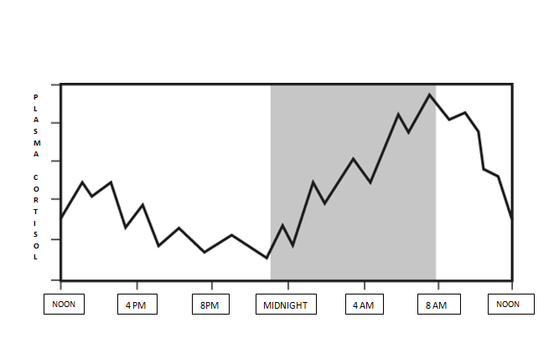

Slide 8
Pharmacological Actions
Direct (Intended) Actions
Anti-inflammatory
Anti-allergy
Anti-immunity
Permissive Actions
    Lipolytic effects
    Effect on bp
    Effect on bronchial muscles
    (e.g.,sympathomimetic amine)

Slide 9
Pharmacological Actions
For most clinical purposes, synthetic glucocorticoids are used because they have a higher affinity for the receptor, are less activated and have little or no salt-retaining properties.
Hydrocortisone used for: orally for replacement therapy, i.v. for shock and asthma, topically for eczema (ointment) and enemas (ulcerative colitis).
Prednisolone the most widely used drug given orally in inflammation and allergic diseases.

Slide 10
Pharmacological Actions
Dexamethasone: very potent, w/o salt-retaining properties; thus, very useful for high-dose therapies (e.g., cerebral edemas).
Beclometasone, diproprionate, budesonide: more active when applied topically Triamcinolone: local joint inflammation (intra-articular inj.).

Slide 11
Actions: Anti-inflammatory
Recruitment of WBC and monocyte- macrophage into affected area & elaboration of chemotactic substances
Lipocortin
ELAM1 and ICAM-1 in endothelial cells
TNF from phagocytic cells
IL1 from monocyte-macrophage
Formation of Plasminogen Activator
Action of MIF and fibroblastic activity
Expression of COX II

Slide 12
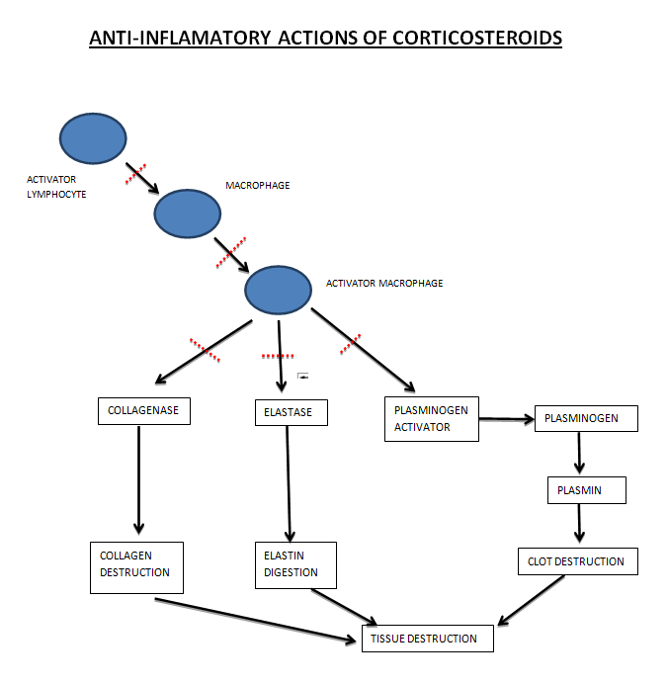

Slide 13
Pharmacological Actions
Stomach
Blood
Anti-inflammatory
Immunosuppressant
Respiratory system
Growth and Cell Division
Calcium metabolism
Carbohydrate
Protein
Lipid
Electrolyte and H₂O
CVS
Skeletal Muscle
CNS

Slide 14
Actions: Electrolyte and water balance
Aldosterone is more important
Act on DT and CD of kidney
  Na⁺ reabsorption
  Urinary excretion of K⁺ and H⁺
Addison’s disease ??
  Na+ loss
  Shrinkage of ECF
  Cellular hydration
  Hypodynamic state of CVS
  Circulatory collapse, renal failure, death

Slide 15
Actions: CNS
Direct:
  Mood
  Behaviour
  Brain excitability
Indirect:
  maintain BBB, circulation and electrolyte balance
ICP (pseudotumor cerebri) - Rare

Slide 16
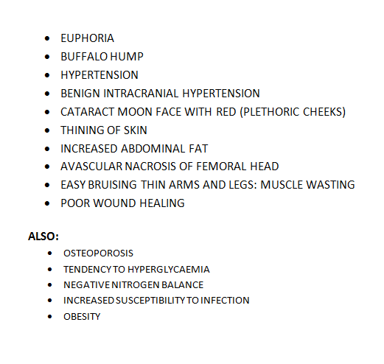

Slide 17
Role in neurosurgery

Slide 18
Role in traumatic spine and head injuries

Slide 19
Pathophysiology of Spinal Cord injury
Primary mechanisms
  Initial crush, shear impingement of cord with the inciting trauma.
Secondary mechanisms
  Vascular insults/insufficiency
  Edema
  Cell toxicity
  Apoptosis

Slide 20
Secondary Mechanisms
Electrolytes
  Calcium release
Cell toxicity
  Glutamate release, arachidonic acid metabolites, free radical generation
Apoptosis
  Programmed cell death
Vascular
  Dysautoregulation, hypotension, neurogenic shock

Slide 21
Secondary mechanisms
Numerous mediators of spinal cord damage have been identified experimentally.
The hope is that through simple pharmacologic interventions, the secondary damage can be limited, or even potentially reversed.
Unfortunately very little clinical progress has been made to date.

Slide 22
Steroids
Several studies have reported success with high dose steroid infusions, limiting progression of spinal cord damage in trauma.
  NASCIS II and III (NEJM 1990, JAMA 1997)
    Two highly publicized studies demonstrating small but clinically significant improvement with neurologic recovery following administration of high dose methyl-prednisolone
      NASCIS II placebo controlled
      NASCIS III dose varied. Not placebo controlled

Slide 23
NASCIS II(National acute spinal cord injury study)
Steroid bolus 30mg/kg over 15min in 1st hour, then 5.4mg/kg/hr for 23 hours
  An average 70Kg patient would receive 23 GRAMS of steroid over 24 hours
NASCIS II was in fact a negative study.
  Only on post hoc sub group analysis did steroid yield a “benefit”
    Only patients who received steroid in the first 8 hours post injury demonstrated a benefit
What degree of benefit however?

Slide 24
NASCIS II
Unfortunately, the degree of “statistically significant benefit” has no clinical relevance
Motor score improvements were 17 .2 and 12.0 for steroid and placebo groups respectively (out of a total possible score of 70), which gives a difference of 5.2.
  A difference of 5.2 simply put could be gained if a patient regained the ability to shrug his shoulders.

Slide 25


NASCIS III
MPSS 24 HR GROUP
MPSS 48 HR GROUP
TIRILAZAD GROUP
5.4 Mg/Kg/Hr. X 24 Hr.
5.4Mg/Kg/Hr. X 48Hr
2.5 Mg/Kg Bolus 6Hrly. X 48Hr
Improved motor fnxn
Improved motor fnxn
Same as MPSS 24 Hr. Group

Slide 26


NASCIS III
MPSS 24 Hr Group
MPSS 48 GRP.
Started in 3 Hrs.
3- 8 Hrs.
Started within 3 Hrs.
Started within 3 to 8 Hrs.
Significant better
Significant better
Poor recovery
Pneumonia/Sepsis

Slide 27
Results
Initiation of treatment within the first 3 hours is optimal
The nonglucocorticoid tirilazad is as effective as 24-hour MP therapy; and
If treatment is initiated more than 3 hours post-SCI, extension of the MP dosing regimen is indicated, from 24 hours to 48 hours.

Slide 28
Results
However, in comparison with the 24-hour dosing regimen, significantly more glucocortioid-related immunosuppressive side effects were seen with more prolonged dosing
In contrast, tirilazad showed no evidence of steroid-related side effects, suggesting that this nonglucocorticoid 21-aminosteroid would be safer for extension of dosing beyond the 48-hour limit used in NASCIS III.

Slide 29
Suggested Indications for the Use of MP in Acute SCI
For acute non-penetrating SCI (<3 h after injury), MP should be given as per NASCIS II protocol (i.e. 24 hours of treatment)
For acute non-penetrating SCI (>8 h after injury), MP should not be used
For acute non-penetrating SCI (after 3 h, within 8 h), MP should be given as per NASCIS III protocol (i.e., 48 h of treatment)
For acute penetrating SCI, MP is not recommended

Slide 30
Controversies
Comparison of 24-h vs. 48-h MP dosing
No placebo group for comparison
Increased rates of wound infection/severe sepsis
No significant benefit at 1 year follow up
Benefits noticed in post hoc analysis only
Fehlings MG. Editorial: recommendations regarding the use of methylprednisolone in acute spinal cord injury: making sense out of the controversy. Spine 26[Suppl 24): 56–57, 2001.

Slide 31
Conclusion
Bracken et al
“Given the devastating impact of SCI and the evidence of a modest, beneficial effect of MP, clinicians should consciously consider using this drug despite the well-founded criticisms that have been directed against the NASCIS II and III trials. With great understanding of the biomolecular events contributing to the pathogenesis of SCI, it is hoped that other neuroprotective agents will enter into clinical practice in the next 5-10 years”

Slide 32
Important Papers
NASCIS II
  NEJM 1990 322:1405-11
NASCIS III
  JAMA 1997 277:1597-1604
Revisiting NASCIS II & III
  J. Trauma 1998 45:6 1088-93
Methylprednisolone for acute spinal injury….
  J. Neurosurg (Spine 1) 2000:93:1-7

Slide 33
Head injury

Slide 34
CRASH
Corticosteroid Randomisation After Significant Head Injury
A large simple placebo controlled trial, among adults with head injury and impaired consciousness
Studied the effects of a 48-hour infusion of corticosteroids on death and neurological disability

Slide 35
Aggregate mortality from 13 randomised trials of steroids in head injury
40%
39%
37%
DEAD
35%
DEAD
422
396
out of
out of
1087
1061
30%
Steroid
Control
Alderson P, Roberts I. BMJ 1997;314:1855-9

Slide 36
Aim
To determine reliably the effects of high dose corticosteroid infusion on:
  death and disability after head injury
  risk of infection and gastrointestinal bleeding
Primary outcomes
  Death within 2 weeks
  Death or disability at 6 months

Slide 37
Results
10,008 adults with head injury and a Glasgow Coma Scale score of 14 or less, within 8 h of injury
48-h infusion of corticosteroid (methylprednisolone) or placebo.
Data at 6 months were obtained for 9673 (96.7%) patients.
.

Slide 38
Results
The risk of death was higher in the corticosteroid group than in the placebo group (1248 [25.7%] vs 1075 [22.3%] deaths; relative risk 1.15, 95% CI 1.07-1.24; p=0.0001)
There was no evidence that the effect of corticosteroids differed by injury severity or time since injury.
These results lend support to earlier conclusion that corticosteroids should not be used routinely in the treatment of head injury

Slide 39
Discussion
Landmark for head injury research
Also a red flag warning clinical trials
Planned to randomize 20,000 patients
Powered to detect a drop in mortality from 15% to 13% (?? Only 2%)
Document relatively small but important improvements in outcome

Slide 40
CRASH data safety monitoring board asked that the trial be stopped after 10,008 patients from 239 hospitals in 49 countries had been randomized

Slide 41
WHY ??
No evidence that MPSS improved survival
Mortality was greater in the MPSS treated patients
1248 [25.7%] vs 1075 [22.3%]
Relative risk 1.15, p=0.0001
Risk could not be attributed to injury

Slide 42
References
Final results of MRC CRASH, a randomized placebo-controlled trial of intravenous corticosteroid in adults with head injury—outcomes at 6 months. Lancet 365: 1957–1959, 2005
Alderson P, Roberts I: Corticosteroids for acute traumatic brain injury. Cochrane Database Syst. Rev 2:CD000196, 2000.
CRASH (CORTICOSTEROID RANDOMIZATION AFTER SIGNIFICANT HEAD INJURY TRIAL): LANDMARK AND STORM WARNING.Neurosurgery 57:1300-1302, 2005

Slide 43
Brain tumors
  Pituitary adenoma
  Gliomas
  Meningiomas
Brain edema
Spinal pathologies
Vascular

Slide 44
Pituitary adenoma

Slide 45
Glucocorticoid Replacement in Pituitary Surgery: Guidelines for Perioperative Assessment and Management
The first decision regarding the perioperative use of glucocorticoid cover depends on the result of the preoperative screening test
Abnormal ACTH 1–24 (Synacthen) test.
  dose regimen, using hydrocortisone, is
    50 mg every 8 h on d 0,
    25 mg every 8 h on d 1, and
    25mg at 0800 h on d 2.
  alternative regimen, using dexamethasone
    4mg at induction of anesthesia,
    2 mg at 0800 h on d 1, and
    0.5 mg at 0800 h on d 2.
  Dexamethasone has the advantage of a long half-life, which allows for single daily administration.
Individuals with normal HPA axis function show a return to baseline cortisol secretion within 48 h of major surgery, providing that no complications have occurred*
* Salem M, Tainish RE, Bromberg J, Loriaux DL, Chernow B 1994 Perioperative glucocorticoid coverage. A reassessment 42 years after emergence of a problem. Ann Surg 219:416–425

Slide 46
Pre-operative
Normal ACTH 1–24 (Synacthen) test.
If neurosurgeon is able to perform a selective adenomectomy
  no perioperative glucocorticoid cover be given
  There is good evidence that such an approach is safe in this patient group
If selective adenomectomy is not possible and surgery is more extensive
  Glucocorticoid cover for 48 h and proceed as above.
  Otherwise, we recommend measuring 0800 h plasma cortisol on d 1–3 postoperatively. Again, the subsequent use of glucocorticoidreplacement depends on these results

Slide 47
Post-operative
Many patients show a rapid increase in pituitary hormone secretion after pituitary adenomectomy
Result of increased flow of hypothalamic releasing hormones through the hypothalamic-hypophysial portal system
A patient with hypopituitarism may gain full functional recovery, providing that viable normal pituitary tissue remains in situ.
Prolonged treatment with high doses of glucocorticoids postoperatively may result in adrenal suppression and mask those who spontaneously recover function.

Slide 48
Post-operative
Provided there are no postoperative complications, glucocorticoid supplementation should be withdrawn, after 48 h
Measurement of 0800 h plasma cortisol levels performed daily between d 3 and 5 postoperatively
Daily clinical assessment of the patient, together with these cortisol results, will determine the subsequent use of glucocorticoid replacement therapy

Slide 49
ACTH-secreting adenomas
Cushing’s disease presents a special situation, with all patients requiring perioperative glucocorticoid cover.
The presence of low plasma cortisol levels postoperatively implies a surgical cure
  Patients with low plasma cortisol levels after pituitary surgery for Cushing’s disease require physiologic hydrocortisone replacement therapy with ongoing review of their HPA axis.
  The aim is to gradually withdraw the hydrocortisone as the ACTH suppression recovers.

Slide 50
ACTH-secreting adenomas
Normal plasma cortisol levels postoperatively usually indicate ongoing autonomous ACTH secretion.
The clinician must decide whether early repeat surgery is indicated or use an alternative modality of treatment, such as radiotherapy or adrenolytic therapy.
Estimation of 24-h urinary free cortisol may help in this decision and may be performed while receiving physiological replacement with dexamethasone (0.5–0.75 mg daily).
The CRH test and ACTH 1–24 test have also been used in this setting but, overall, seem to add little to the basal measurements of plasma and urinary free cortisol in predicting relapse.

Slide 51
Early postoperative assessment
Based on the levels of 0800 h plasma cortisol in the early postoperative period
These measurements should be made on
  d 1–3 in patients not treated with glucocorticoids and
  d 3–5 in patients covered with glucocorticoids for the initial 48 h

Slide 52
Guidelines for the further investigation and management of glucocorticoid replacement based on postoperative 0800 h plasma cortisol levels
0800-h Cortisol level (nM) | Glucocorticoid replacement (hydrocortisone equivalent) | Definitive test required
< 100 | 15–30 mg/d (maintenance) | No—deficient HPA axis
100–250 | 10–20 mg, single morning dose | Yes
250–450 | Stress only, safe to withhold routine replacement until definitive test | 0800 h cortisol d 7 Yes if 350 nM
> 450 | No | No—normal HPA axis

Slide 53
  Who needs a definitive test of their HPA axis?
Only in those patients with postoperative 0800 h cortisol levels between 100 and 350 nm
A repeat 0800 h plasma cortisol at 4–6 wk, 24 h after the last dose of hydrocortisone, may provide additional evidence for normal HPA function.
Plasma cortisol levels more than 350 nm are highly suggestive of normal pituitary-adrenal function
Those patients with levels less than 100 nm are likely to remain ACTH deficient

Slide 54
Who needs a definitive test of their HPA axis?
There are cases where late recovery of the HPAaxis is documented
A repeat 0800h cortisol, 24 h after the last dose of hydrocortisone, performed between 4 and 6 wk postoperatively, should identify such patients.
Those still less than 100 nm require lifelong replacement therapy, whereas those whose cortisol levels have risen to more than 100 nm should undergo a definitive test and replacement

Slide 55
Pituitary apoplexy
Steroid therapy in pituitary apoplexy
Patients with pituitary apoplexy, who are haemodynamically unstable
Empirical steroid therapy.
In adults hydrocortisone 100-200mg as an intravenous bolus is appropriate, followed by
2-4mg per hour by continuous intravenous infusion or 50-100mg six hourly by intramuscular injection, after drawing blood samples for random cortisol, FT4, TSH, PRL, IGF1, GH, LH, FSH, testosterone in men, oestradiol in women, electrolytes, renal function, liver function, full blood count and clotting screen;
Indications for empirical steroid therapy in patients with pituitary apoplexy are
  haemodynamic instability,
  Altered consciousness level,
  reduced visual acuity and
  severe visual field defects
• Patients who do not fulfil the criteria for urgent empirical steroid therapy should be considered for treatment with steroids, if their 09.00 serum cortisol is less than 550nmol/l;

Slide 56
Orders in neurosurgery
Pre-op
T eptoin
T decdac
T rantac
C b/c
Post-op
Inj phenytoin
Inj clox
Inj amikacin
Inj wymesone
Inj rantac
Inj ketonov

Slide 57
History of use of steroid in tumor
Steroids were introduced into the care of brain cancer patients nearly 50 years ago based on their powerful effects on tumor-induced edema
Ingraham pioneered the use of cortisone to treat postoperative cerebral edema in neurosurgical patients in 1952
Kofman first used prednisone for peritumoral edema from brain metastases in 1957
More than 40 years ago, Galicich demonstrated that dexamethasone effectively alleviated cerebral edema due to brain tumors

Slide 58
Dexamethasone, which was first synthesized in 1958, to date has remained the most favorable drug for brain cancer patients.
Dexamethasone has become the drug of choice in neuro-oncology, in part owing to its long half-life, low mineralocorticoid activity, and a relatively low tendency to induce psychosis.
Subsequently, prednisone, prednisolone, dexamethasone and methylprednisolone have demonstrated antineoplastic effects against malignancies

Slide 59
Molecular Mechanisms
At transcriptional levels, glucocorticoids suppress synthesis of several cytokines and chemokines, such as GM CSF; IL-1β, -4, -5, -8 and -10; as well as eotaxin and lipocortin 1, which are involved in the regulation of the inflammatory reaction.
Interact with other transcription factors such as NF-κB, activating protein 1, p53, CRE-binding protein, signal transducer & the STAT3, STAT5 and others, indirectly influencing the activity of the latter on their own target genes
NF-κB activates many of the inflammatory pathways through its regulation of the production of proinflammatory cytokines and chemokines. Inhibition of NF-κB results in an anti-inflammatory effect

Slide 60
Disruption of the BBB
Trauma
Inflammatory and autoimmune disease,
Infection
Cerebrovascular disease
Neurodegenerative disease
Epilepsy, and
Neoplasia

Slide 61
Disruption of the BBB
Klatzo first characterized brain edema as a cytotoxic versus a vasogenic process
BBB remains intact in cytotoxic edema
Corticosteroid therapy after brain tumor surgery helps re-establish the BBB integrity.
Cairncross JG, Macdonald DR, Pexman JH, et al: Steroid-induced CT changes in patients with recurrent malignant glioma. Neurology 1988; 38:724-726

Slide 62
Cerebral edema
Vasogenic edema
Cytotoxic edema
Interstitial edema

Slide 63
Steroids
Glucocorticoids primarily reduce vascular permeability of vessels rather than reduced VEGF production
This inhibition of the effects of VPF/VEGF on the vasculature is associated with interference of VEGF's action on vessels and requires the glucocorticoid receptor
Thus, the effects of steroids in tumor-induced vasogenic edema is to restrict permeability of the BBB to macromolecules
By contrast, steroids are not effective when the BBB is not functional
Heiss JD, Papavassiliou E, Merrill MJ, et al: Mechanism of dexamethasone suppression of brain tumor-associated vascular permeability in rats. Involvement of the glucocorticoid receptor and vascular permeability factor. J Clin Invest 1996; 98:1400-1408.
. Merrill MJ, Oldfield EH: A reassessment of vascular endothelial growth factor in central nervous system pathology. J Neurosurg 2005; 103:853-868.

Slide 64
Cranial surgery: Brain tumor
Several days before surgery when there is symptomatic brain edema or mass effect
Typical dose is 16 mg/day or 4 mg four times a day
In brain edema, there appears to be a dose threshold that must be surpassed before symptomatic benefit is derived
Therefore, dexamethasone should be started at a high dose in patients with large amounts of brain edema and then reduced after neurological improvement has occurred.

Slide 65
Pre-op
Patients respond within 24 hours of beginning steroid treatment
Decrease tumor capillary permeability and tumor blood volume
In patients undergoing more elective surgery, such as those with schwannomas and meningiomas, may be given steroids beginning 3 days before surgery
However, if there is only minimal edema, steroids are typically first given at time of surgery

Slide 66
Post-op
Patients at risk for the development of significant postoperative edema are:
  deep intrinsic tumors in which only minimal resection was possible
  infiltrating tumors involving a large amount of white matter, and
  extensive edema before surgery.
  progressive cerebral edema (can also be treatment related)
Maximal postoperative swelling occurs between days 1 and 5 after surgery

Slide 67
Post -op
Regardless of the cause of the cerebral edema, management is similar
These patients should receive maximal medical treatment of the edema and elevated ICP
Steroids should be given at maximal doses (20 mg every 4 hours).
Yamada K, Ushio Y, Hayakawa T, et al: Effects of methylprednisolone on peritumoral brain edema. J Neurosurg 1983; 59:612-619.
Leenders KL, Beaney RP, Brooks DJ, et al: Dexamethasone treatment of brain tumor patients: effects on regional cerebral blood flow, blood volume, and oxygen utilization. Neurology 1985; 35:1610-1616.

Slide 68
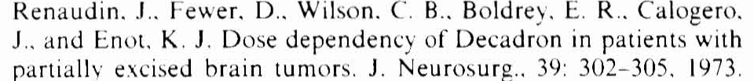
Metastasis
Believe to exert their effect by reducing cerebral edema surrounding tumor,and to lesser extent there may be direct oncolytic effect on tumor cells
Ameliorate sign and symptom in 2/3rd of patients
Benefit evident within 24 hrs.
Minimum effective dose is not known but in practice loading dose equivalent to 10 mg of dexamethasone intravenously, followed by 16 mg orally/IM (divided in 3-4 doses)
Steroids tends to stabilise patient,after which more definitive treatment (surgery/radiotherapy) may be undertaken. May be continued through initial phase and tapered and finally discontinued after 1-2 weeks.
Relief is only temporary.patient tends to relapse despite continued steroid administration

Slide 69
Brain metastasis
All patients should receive steroids.
Rapid improvement within 6-24 hours.
Maximum effect by 3-7 days.
Benefit is temporary.

Slide 70
Dose of Steroids
Most common dose dexamethasone 4 mg qid.
Doses as low as 4 mg qd if not symptomatic.
Up to 100 mg per day if symptoms are progressing.
Taper as tolerated.

Slide 71
Brain abscess
Concurrent treatment with corticosteroids, radiation therapy, and chemotherapy may alter the radiographic progression of abscess development
Corticosteroids have been shown to reduce the thickness of the abscess capsule and the extent of contrast enhancement on both CT and MRI
Cavusoglu H, Kaya RA, Turkmenoglu ON, et al: Brain abscess: analysis of results in a series of 51 patients with a combined surgical and medical approach during an 11-year period. Neurosurg Focus 2008; 24(6):E9

Slide 72
Spinal Indications
Control of pain in low back ache :Epidural injection in lumbar pain
Epidural metastasis (acute phase)
Neurological deterioration after implant migration and /or compression
Rheumatoid arthritis

Slide 73
Miscellenous
Carpal syndrome
Bell’s palsy
Cranial n. damage
Chronic SDH
Dexamethasone suppression test
Neurodegenerative ds.
Meningitis

Slide 74
Meningitis
Reported in the 1950s
Individuals with bacterial meningitis treated with antibiotics plus steroids within 12-24 h of admission had better outcomes
Interestingly, these benefits were not observed if steroid treatment was delayed until 5 days after admission.
Bacterial lysis induced by antibiotics causes inflammation in the subarachnoid space, and this response is attenuated by steroid treatment, thereby improving the outcome
Hoh TK and Mong CT (1962) The treatment of purulent meningitis with adrenal cortico-steroids. SingaporeMed J 3: 73-77

Slide 75
Current Guidelines and Recommendations
Should be administered just before or in conjunction with antibiotic therapy.*
Dexamethasone (10 mg) should be administered intravenously every 6 h for 4 days in adults
At present, children in low-income countries do not seem to derive appreciable benefit from steroid use (??)
In most childhood studies, a 4-day regimen of dexamethasone(0.4 or 0.6 mg/kg per day) divided into four daily doses was used.
We suggest that clinicians consider administering treatment with this 4-day regimen, as most published studies have used this duration of treatment without observing increased adverse effects relative to the shorter durations.
*van de Beek D and de Gans J (2006) Dexamethasone in adults with community-acquired bacterial meninigitis. Drugs 66: 415-427

Slide 76
Meningitis: Tubercular
Current Guidelines and Recommendations*
Stratified dexamethasone treatment regimen
Patients with a Glasgow Coma Scale score of less than 15 or who have a focal neurological deficit are treated with
  intravenous dexamethasone for 4 weeks
    0.4 mg/kg per day in week 1
    0.3 mg/kg per day in week 2
    0.2 mg/kg per day in week 3, and
    0.1 mg/kg per day in week 4, followed by
Taper of oral dexamethasone(4 mg/day, 3 mg/day, 2 mg/day and 1 mg/day, each for a period of 1 week)
*Prasad K et al. Steroids for treating tuberculous meningitis. Cochrane Database of SystematicReviews 2006, Issue 1. Art. No.: CD002244.doi:10.1002/14651858.CD002244.pub2
*Kumarvelu S et al. (1994) Randomized controlled trial of dexamethasone in tuberculous meningitis. TuberLung Dis 75: 203-207

Slide 77
Meningitis: Tubercular
Patients with a normal mental status and no neuro logical findings receive
  intravenous dexamethasone for 2 weeks
    0.2 mg/kg per day in week 1, then
    0.1 mg/kg per day in week 2, followed by
The same oral taper as described above.
steroid treatment should start as soon as possible after initiation of appropriate first-line anti tuberculosis drugs.

Slide 78
Conclusion
Corticosteroids have varied roles in the pathologies of the brain and spine especially in neuro-oncology. However need further evaluation w.r.t.role in trauma

Slide 79
Thank you

